Slide 1
Hosea 11:1-4, 8-9 (NLT)
1 “When Israel was a child, I loved him,
and I called my son out of Egypt.
2 But the more I called to him,
the farther he moved from me,
offering sacrifices to the images of Baal
and burning incense to idols.
3 I myself taught Israel how to walk,
leading him along by the hand.
But he doesn’t know or even care
that it was I who took care of him.

Slide 2
Hosea 11:1-4, 8-9 (NLT)
4 I led Israel along
with my ropes of kindness and love.
I lifted the yoke from his neck,
and I myself stooped to feed him.

Slide 3
Hosea 11:1-4, 8-9 (NLT)
8 “Oh, how can I give you up, Israel?
How can I let you go?
How can I destroy you like Admah
or demolish you like Zeboiim?
My heart is torn within me,
and my compassion overflows.
9 No, I will not unleash my fierce anger.
I will not completely destroy Israel,
for I am God and not a mere mortal.
I am the Holy One living among you,
and I will not come to destroy.

Slide 4
Looking back to see The Heart of God and going forward to live it.
The Book of
Hosea
Glenn Tweedie
August 14th

Slide 5
Hosea
Predominantly a prophet to the northern kingdom
Warning of God’s judgement via the Assyrians
He himself was made an object lesson to the nation
Commanded to marry a prostitute – Gomer
To whom he had three children – prophetic names
Jezreel – a place, symbolic of gross disobedience to God
Lo-Ruhamah - “no mercy”
Lo-Ammi – “not my people”
What picture of God
does this book portray?

Slide 6
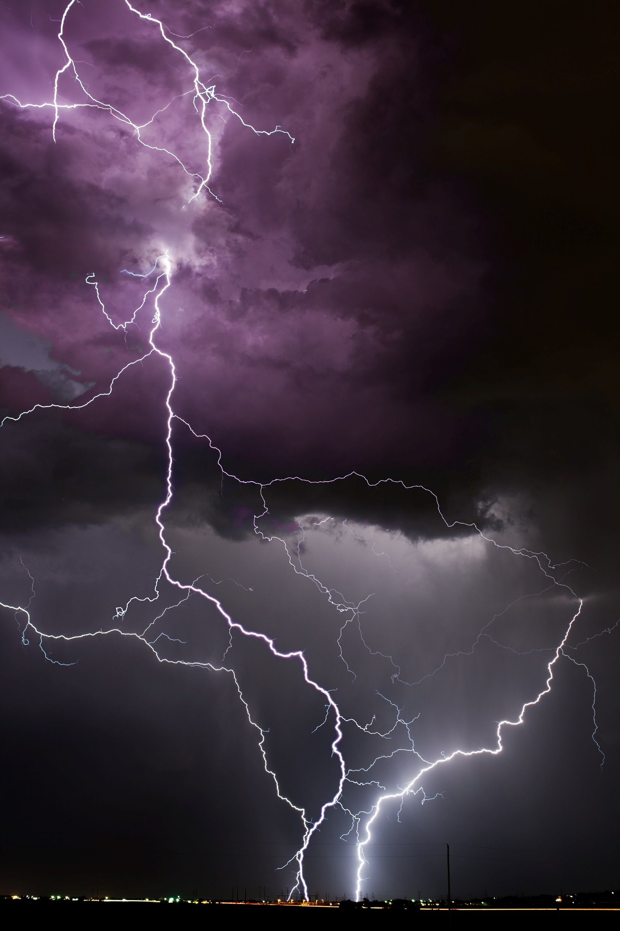
God is angry, just waiting to judge and condemn you. Is that an accurate picture of God?

Slide 7
God loves YOU above everything else.

Slide 8
God loves YOU above everything else.
Romans 5:8 (NLT)
But God showed his great love for us by sending Christ to die for us while we were still sinners.

Slide 9
God’s love for us changes how we relate to Him and to others.

Slide 10
God’s love for us changes how we relate to Him and to others.
1 John 4:17 (NKJV)
Love has been perfected among us in this: that we may have boldness in the day of judgment; because as He is, so are we in this world.

Slide 11
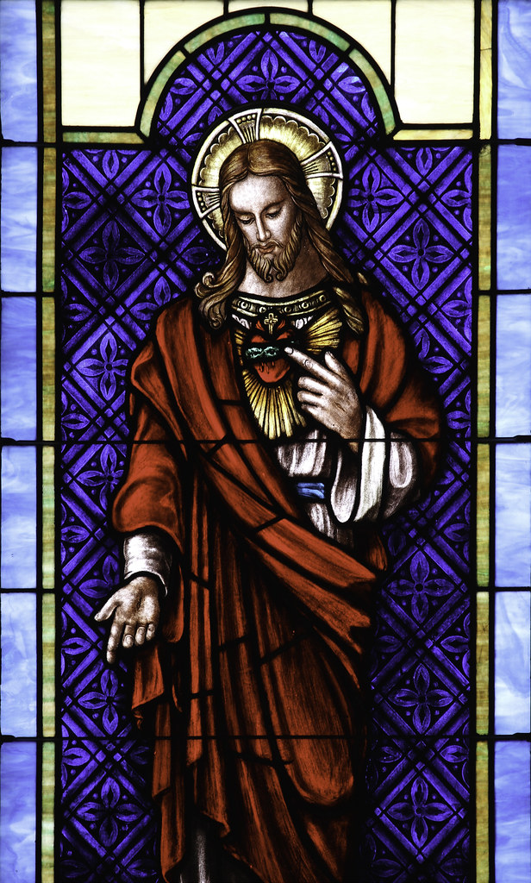
Looking back to Hosea we see the true heart of God. Let us go forward to live it out. As He is, so are we in this world. 1John 4:17b

